Slide 1

Predicting Best Picture Winner
By Vicente Echeveste

Slide 2
Objective:
Can you predict the Winner of an Oscar Category without ever seeing the Film

Slide 3


Resources Used:
Kaggle Oscar Dataset
Supplemented by web scraping from the Academy Awards
OMDBApi
Plot
Runtime
Actors
Etc…

Slide 4
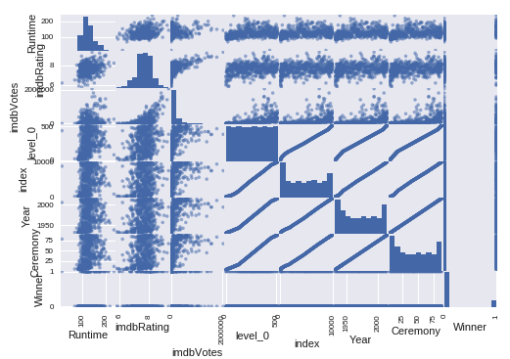
EDA

Slide 5
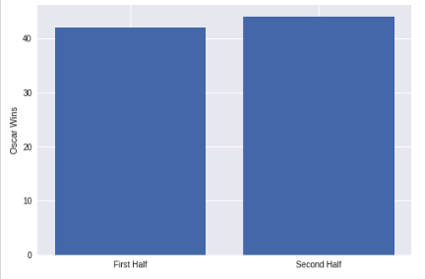
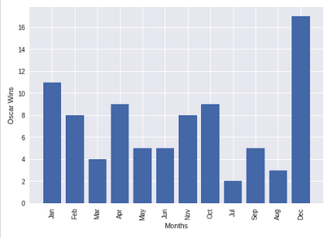
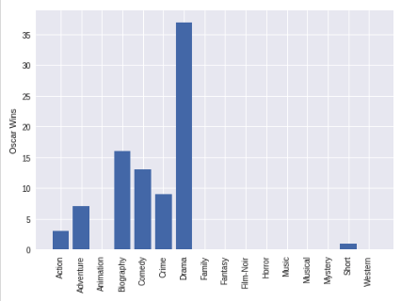
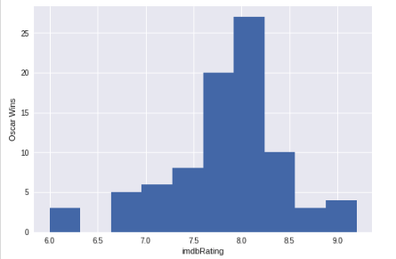
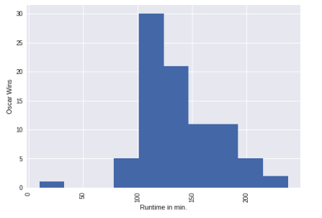
Graphs

Slide 6
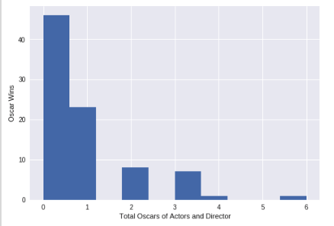
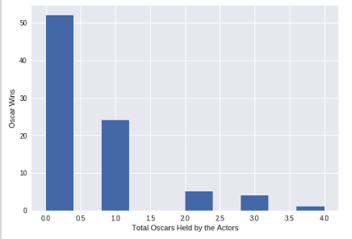
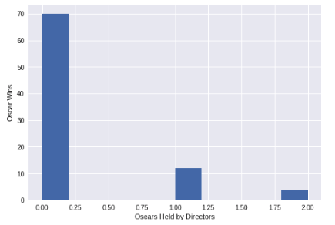
More Graphs

Slide 7
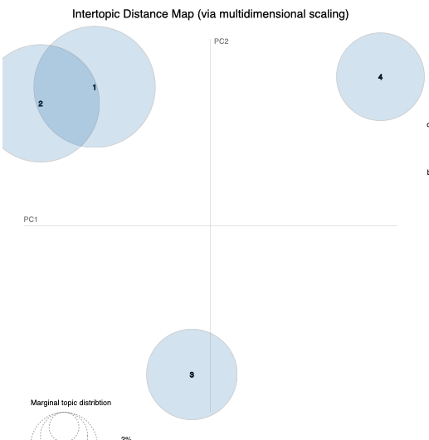
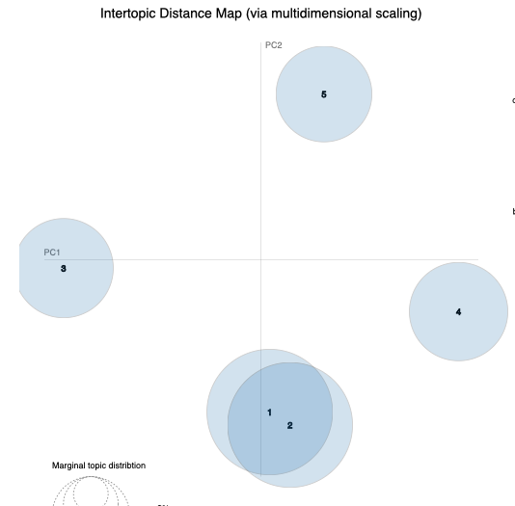
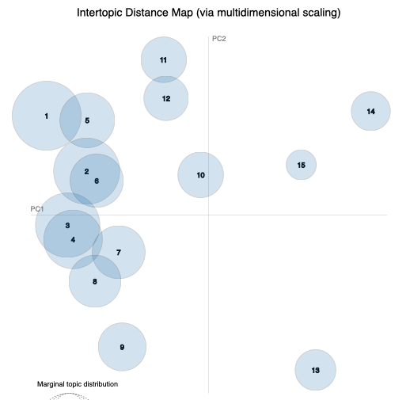
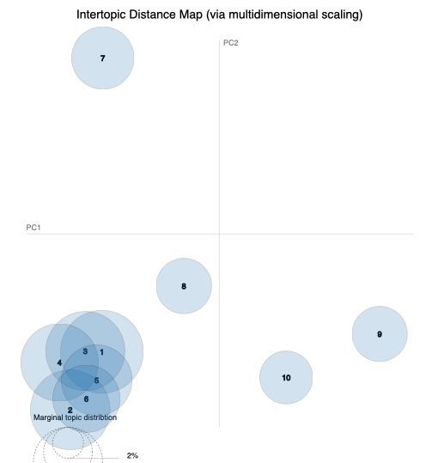
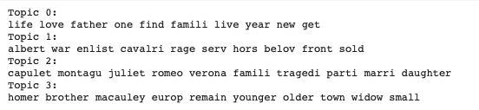
NLTK

Slide 8
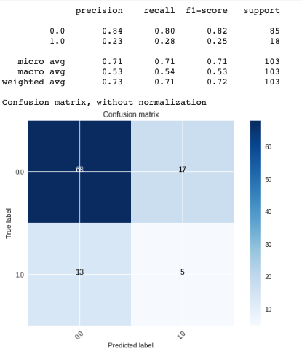
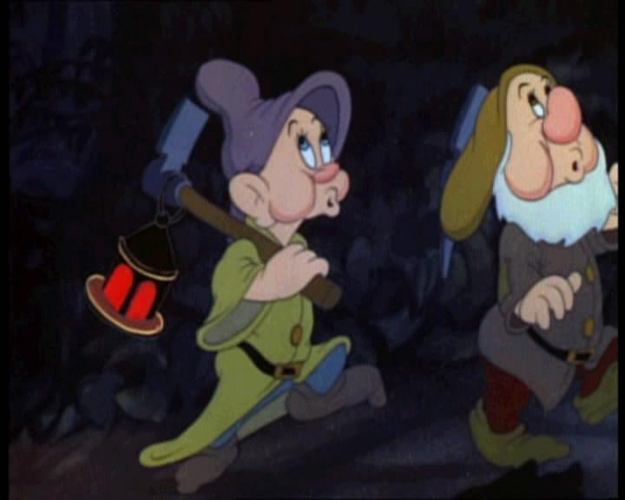
Dummy Classifier
Notes:
Seems allright, lots of misclasifications

Slide 9
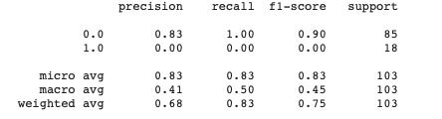
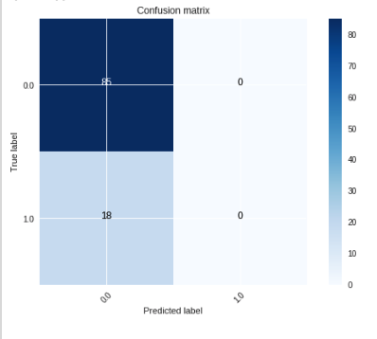

Running Initial Models
Notes:
Even when running the models the accuracy was ~84% in cross validation but it was just predicting the majority values

Slide 10
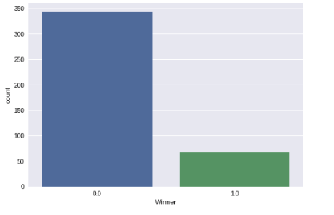
Class Imbalance

Slide 11
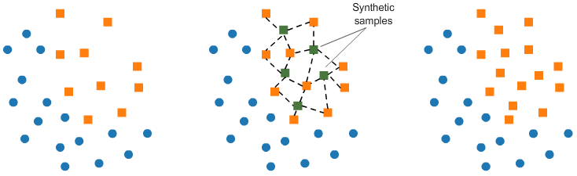
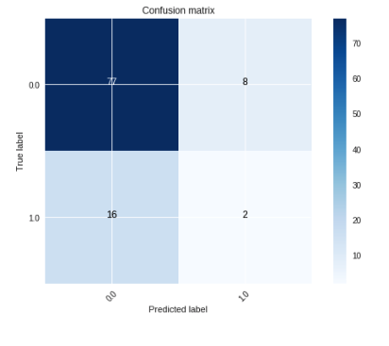
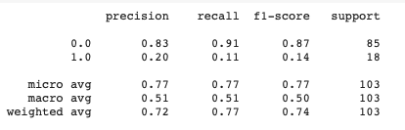
SMOTE

Slide 12

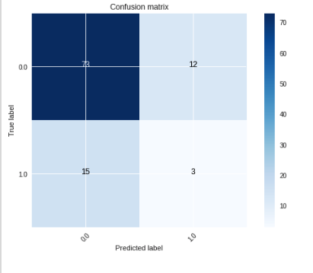
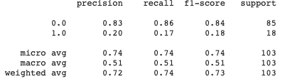
TOMEK Links

Slide 13
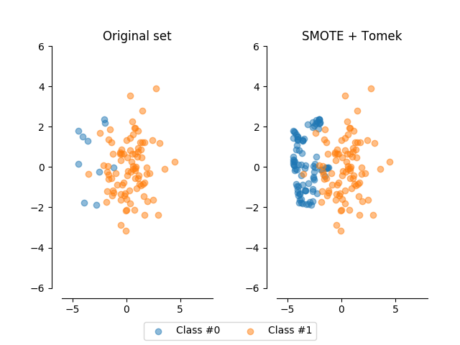
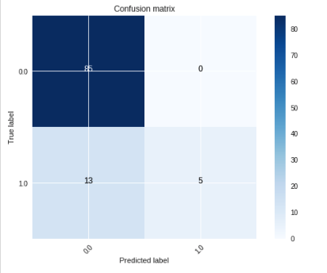
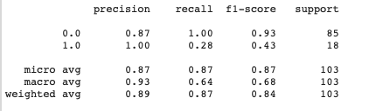
SMOTETomek

Slide 14
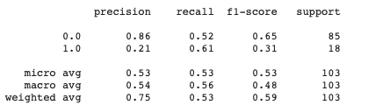
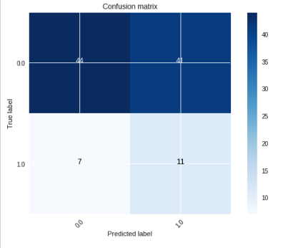

Sanity Check

Slide 15


Slide 16
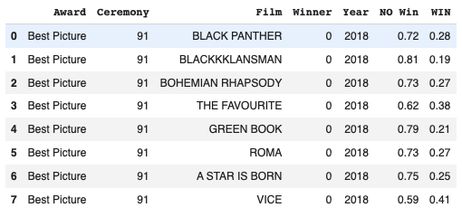

Slide 17
Next Steps
Looking at predictions in terms of probabilities to build a better model
Modeling a different time period
Movie preference have changed since the 1920s so having the extra information in the model might be counter productive
Looking at other predictors such as sentiment analysis on:
News
Twitter
Increasing features to include Box Office Gross
Separating Nomination and Win totals to their respective awards:
Golden Globes
Other Film festivals

Slide 18
THE END

